Slide 1



Name: Jedidiah Kojo Tetteh
Email: tettehjedidiah@gmail.com
Company: Soko Aerial
Department: Communication and Defense Engineering
Position: Assistant

Slide 2
MISSION PLANNER
Mission Planner is a ground control station for planes, helicopters, and rovers. It's only compatible with Windows. For your autonomous vehicle, Mission Planner can be used as a configuration tool or as a dynamic control supplement. Helps to
Load firmware into your autopilot board that controls your vehicle
Setup, configure and tune your vehicle for optimum performance
Plan, save and load autonomous missions into your autopilot
Download and analyze missions log created by your autopilot
Monitor your vehicle’s status while in operation
Record telemetry logs which contain much more information
View and analyze the telemetry logs

Slide 3
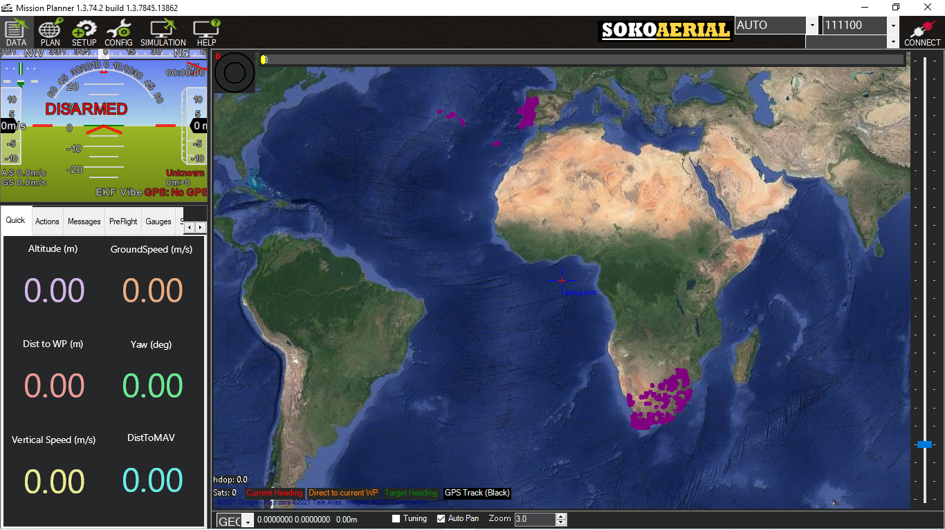
MISSION PLANNER ENVIRONMENT

Slide 4
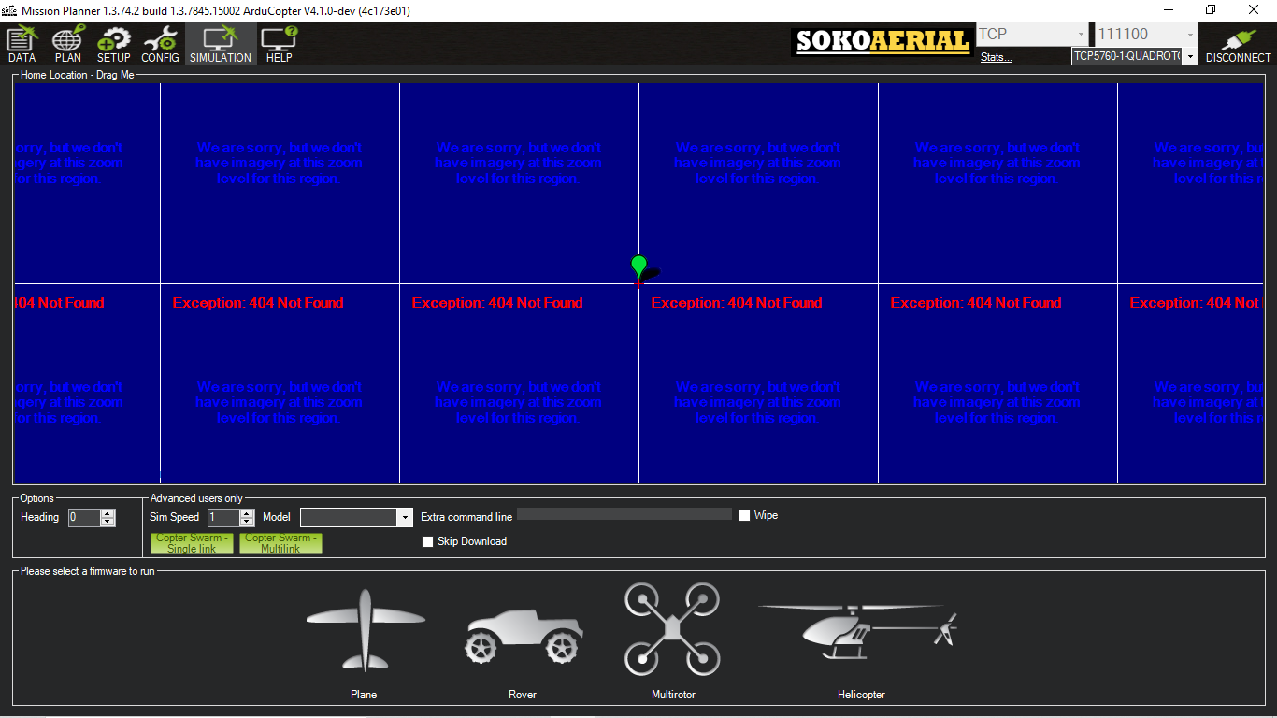
FIRMWARE

Slide 5
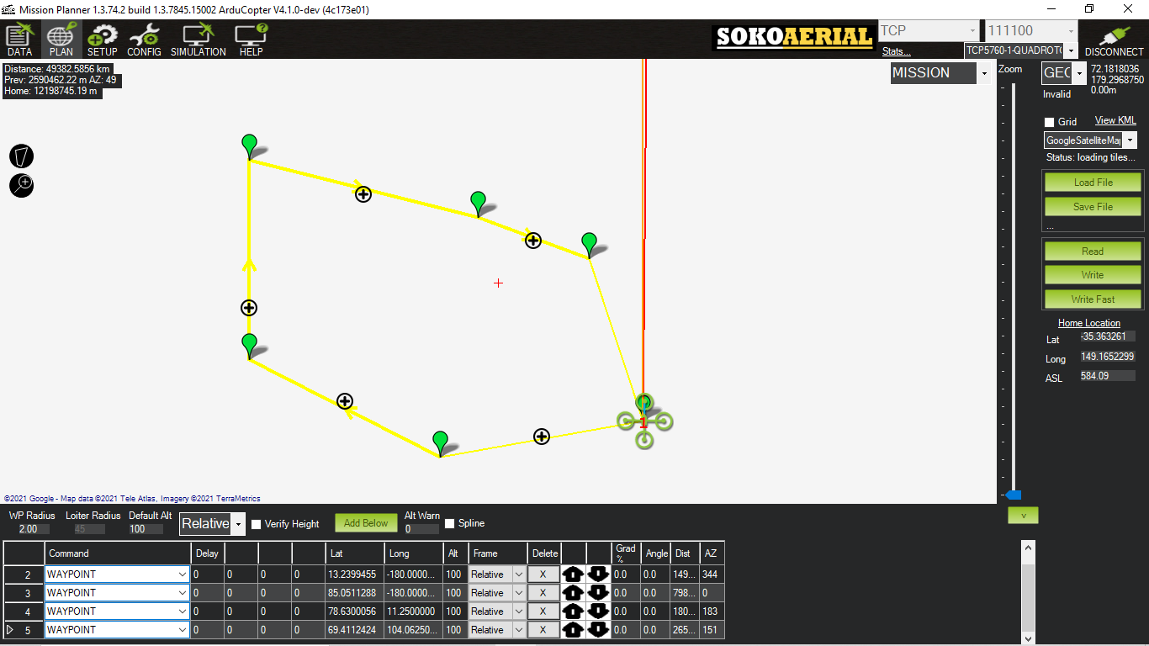
MISSION PLANNER

Slide 6
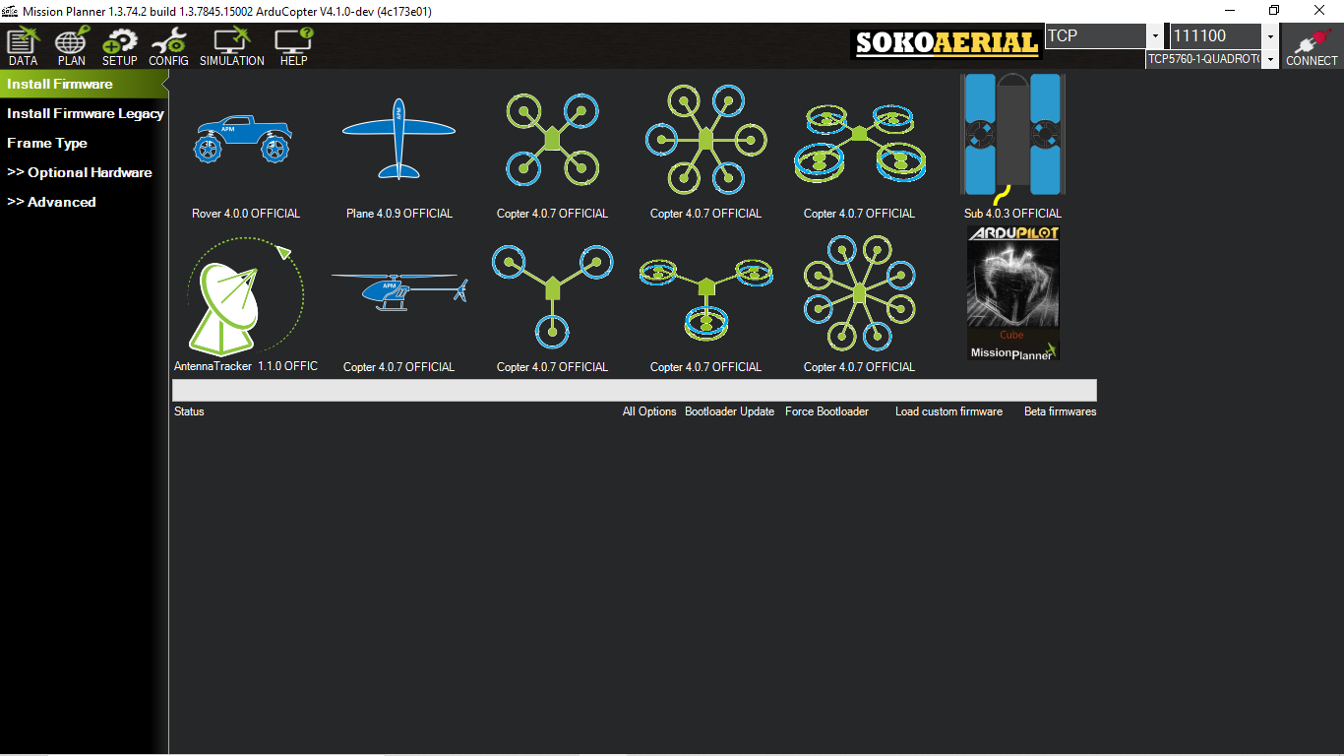
INSTALL CUSTOM / FIRMWARE

Slide 7
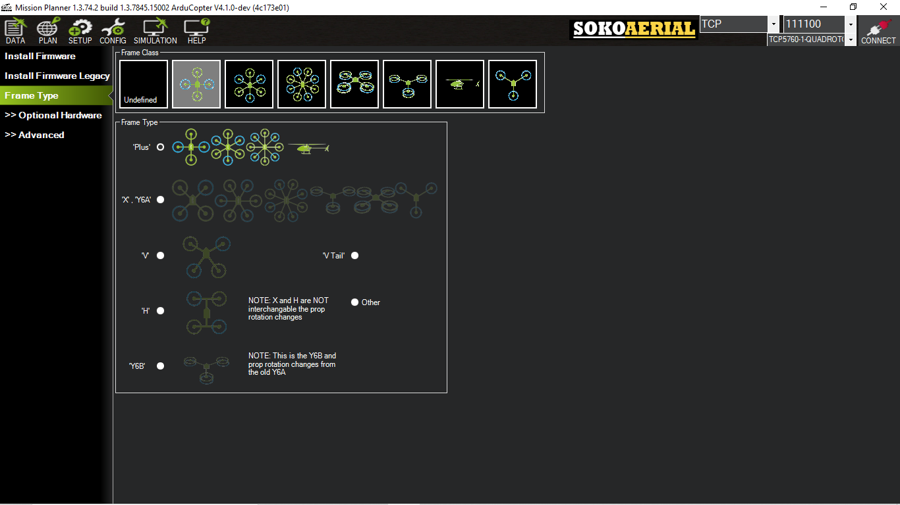
FRAME TYPE

Slide 8
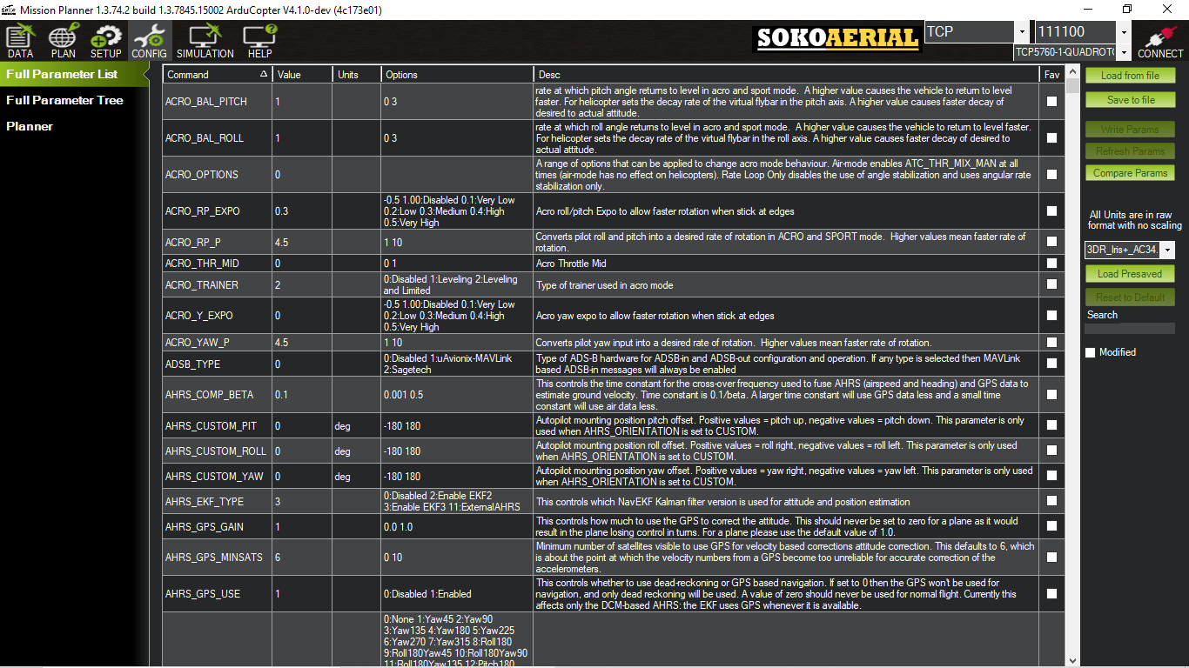
CONFIGURAION

Slide 9
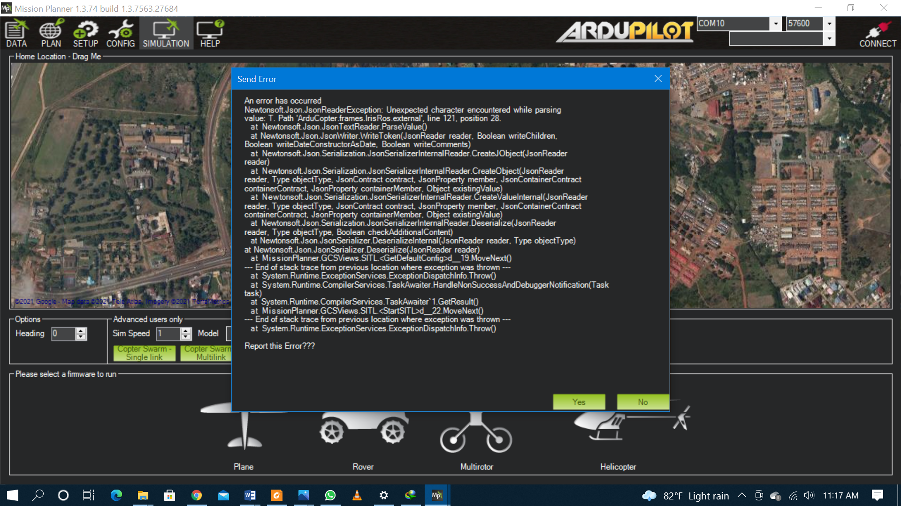
UNABLE TO DOWNLOAD FIRMWARE ON THE PREVIOUS VERSION

Slide 10
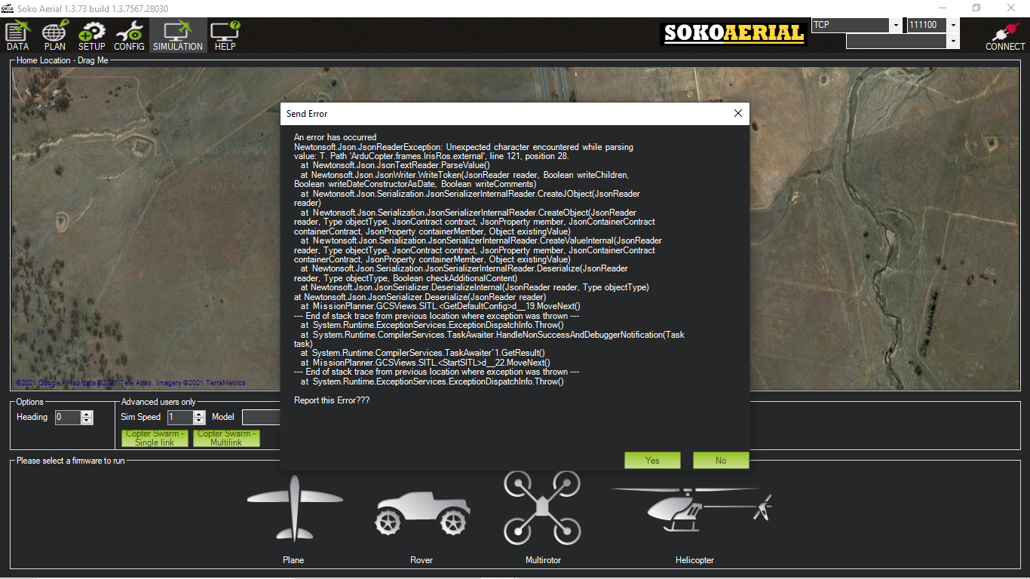
UNABLE TO DOWNLOAD FIRMWARE ON THE PREVIOUS VERSION

Slide 11
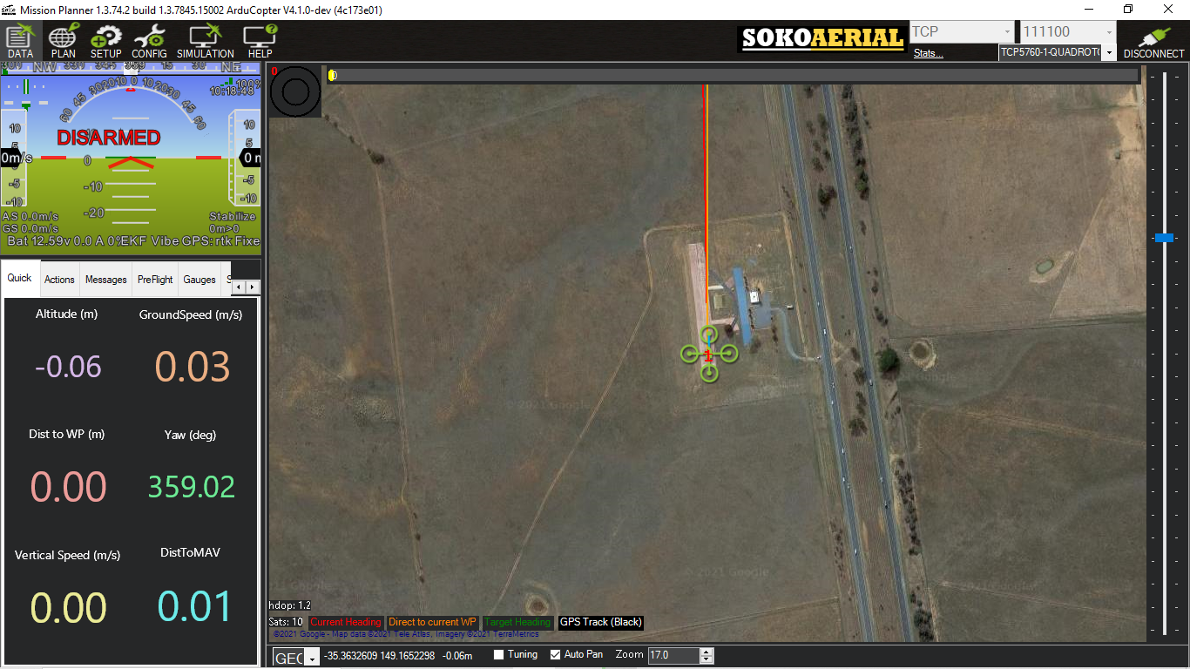
PROBLEM SOLVED WITH THE NEW VERSION

Slide 12
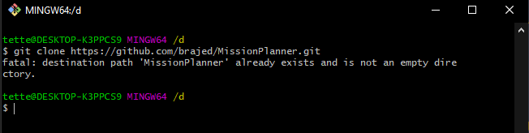
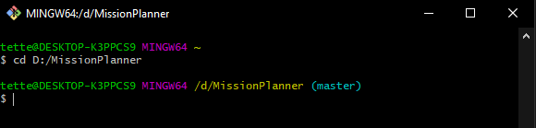
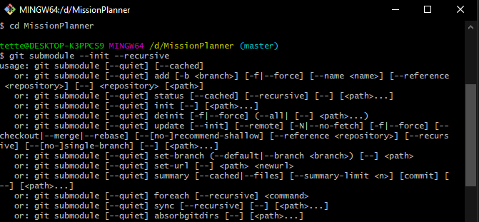
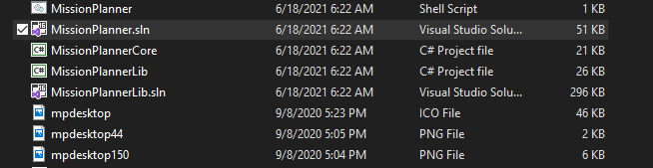
STEPS FOR DEVELOPMENT STEP 1
Install any of this Visual Studio Community, Professional or Enterprise
Download and Install git bash
Git fork https://github.com/ArduPilot/MissionPlanner with your github account and open git bash terminal
Type git clone https://github.com/brajed/MissionPlanner.git
After downloading, type this in the same terminal cd c:/MissionPlanner
Once the directory is open, type git submodule --init --recursive
Whiles still connected to internet, double click on MissionPlanner.sln

Slide 13
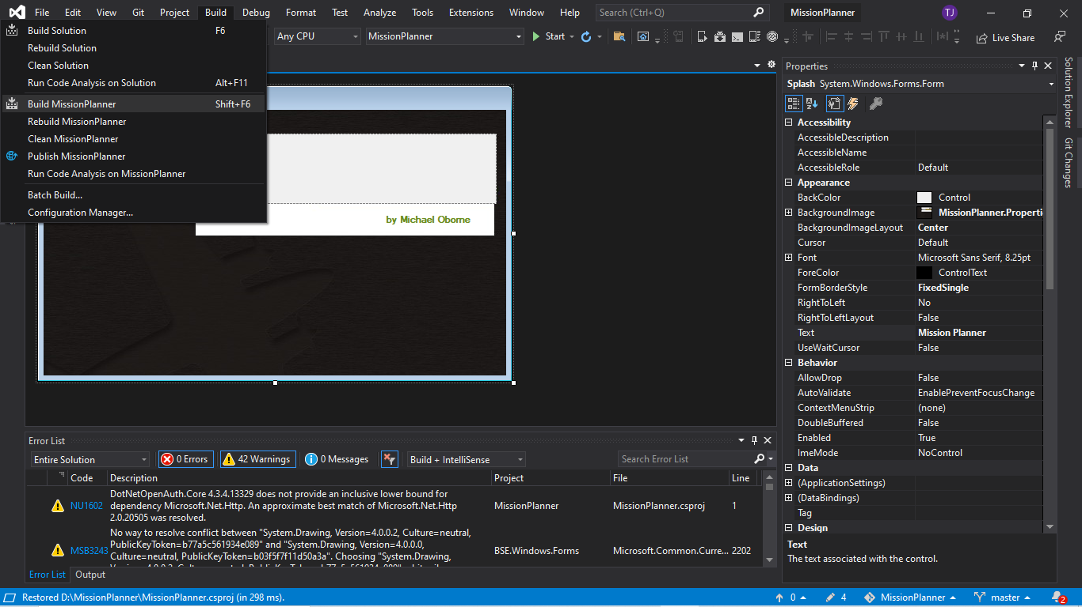
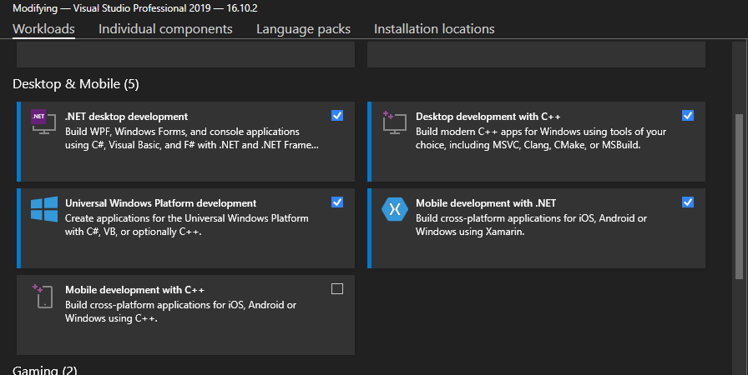
STEPS FOR DEVELOPMENT STEP 2
Building for the first time, you might encounter an error depending on your visual studio version but you can solve the errors by installing the workloads selected below
Click on Build option and select Build MissionPlanner . You can now edit once you have a successful build

Slide 14
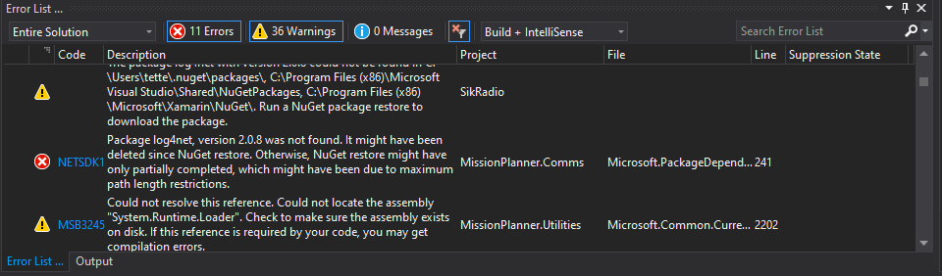
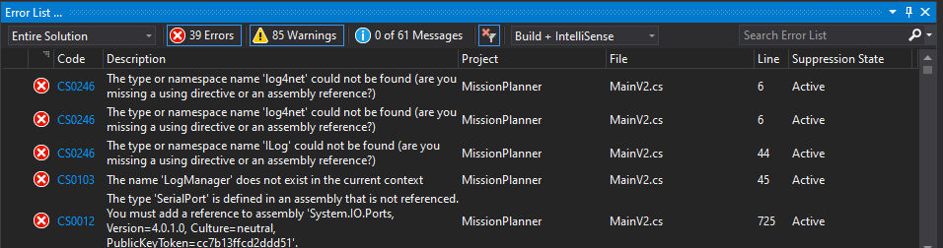
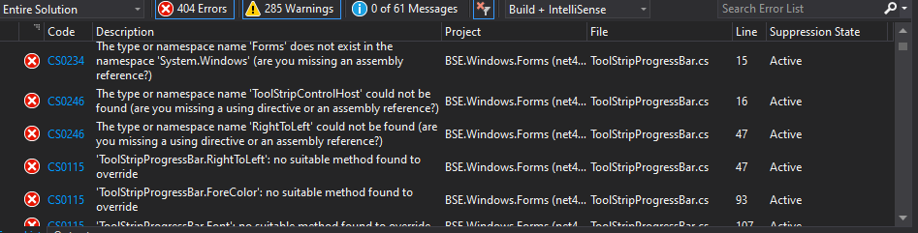
COMMON ERRORS

Slide 15
REFERENCES
https://github.com/ArduPilot/MissionPlanner
http://discuss.ardupilot.org/c/ground-control-software/mission-planner

